Slide 1
Group Salmon: Rep Token

Slide 2
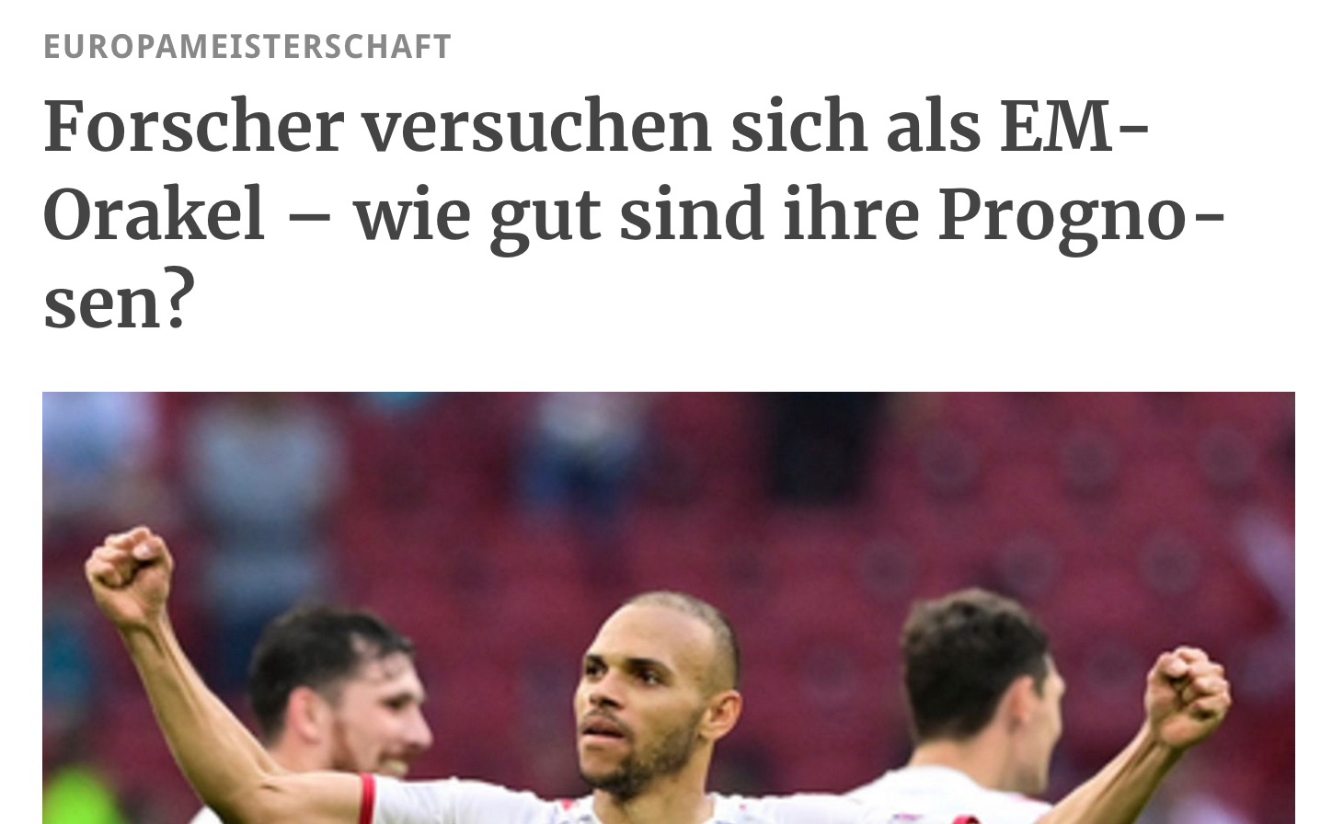
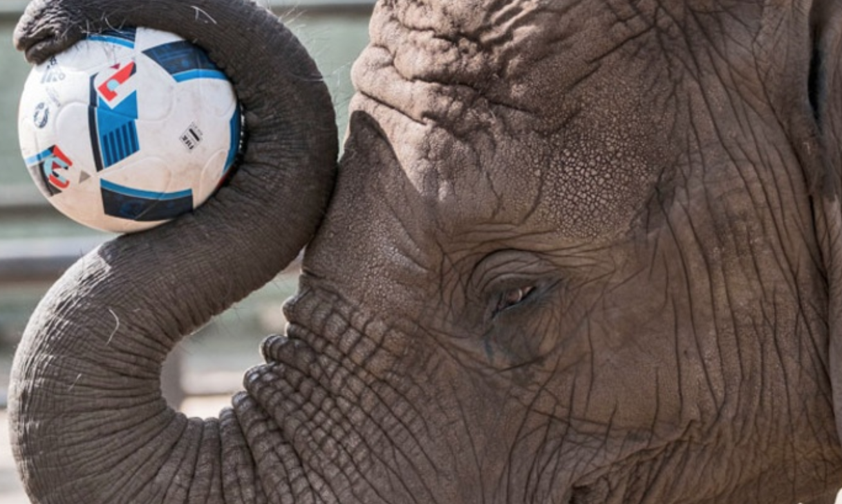
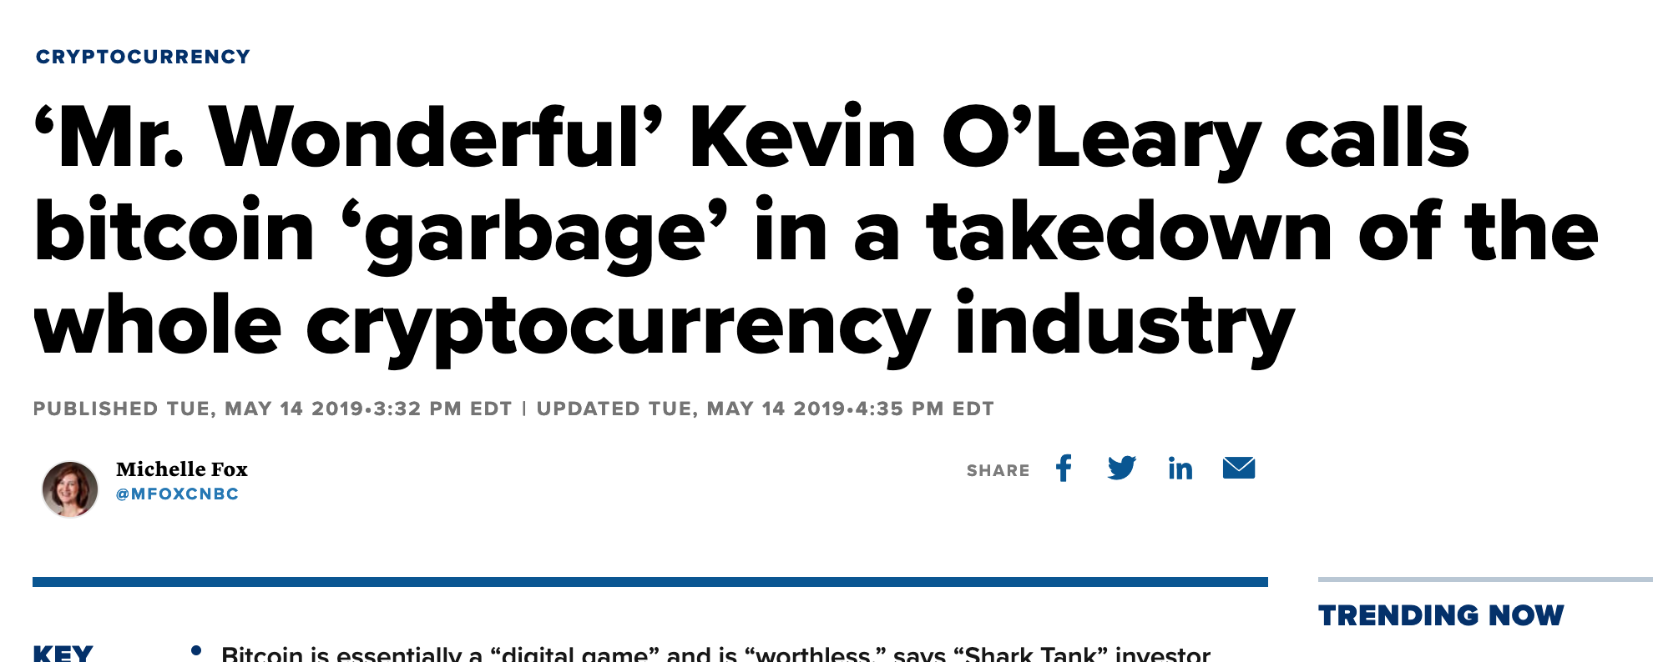
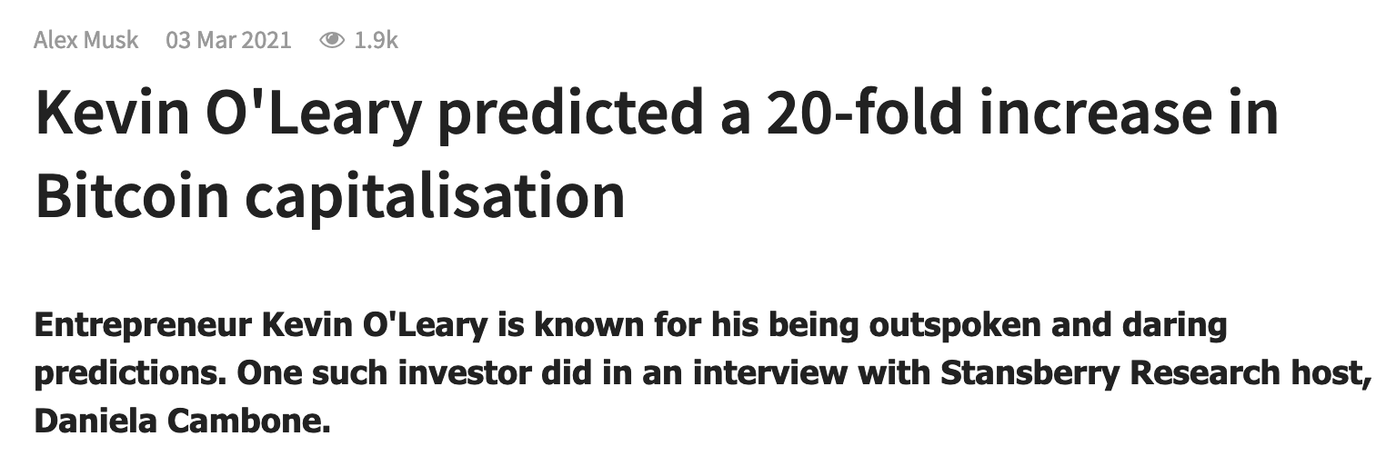
Problem statement
Self-proclaimed experts make predictions
Harm real experts in the field
Trick unaware people
People don’t know who to trust

Slide 3
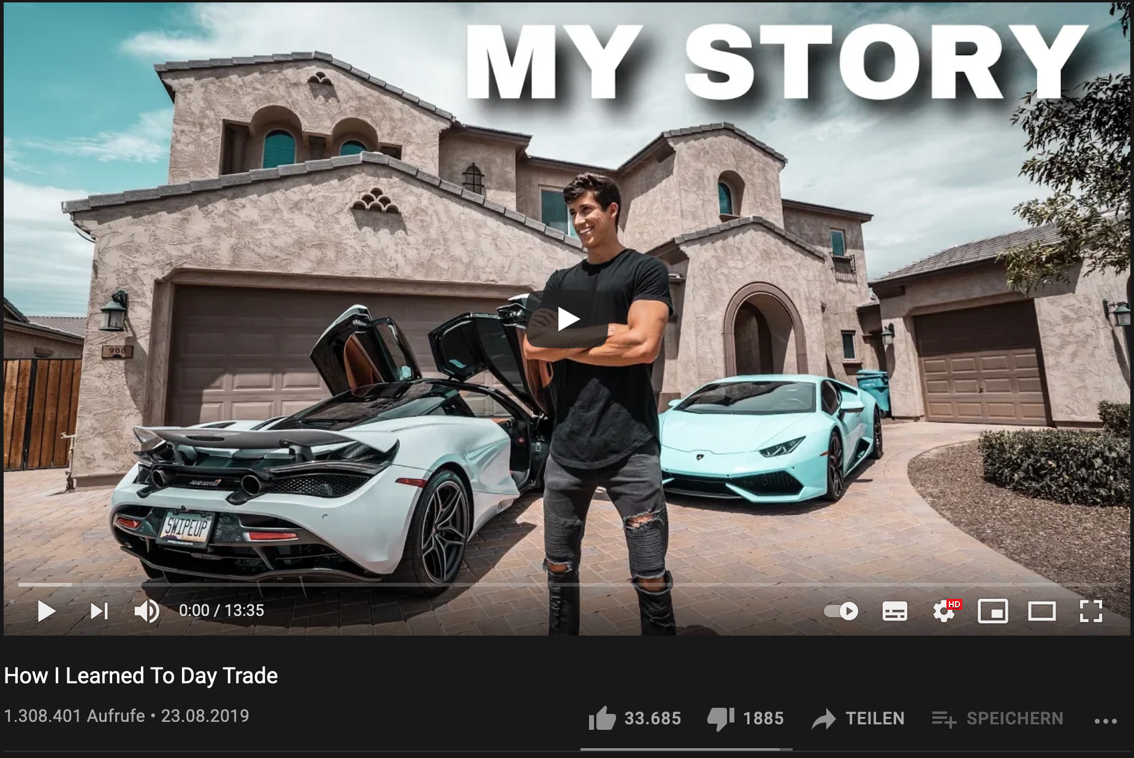
Solution: Rep Token
Indicator for how accurate stock predictions had been
Field has high incentive to lie
Uses the transparency of the blockchain
Wrong predictions can not be removed
Predictions can only be made before the event takes place
Give silent experts a strong argument against fake gurus

